Slide 1
Social Media Sentiment Analysis
Delivery #6 - Final Presentation
Group #3
Göksel Tokur - 150116049 gokseltokur04@gmail.com (Computer Engineering)
Arda Bayram - 150116029 arda.bayram1998@gmail.com (Computer Engineering)
Gülnihal Erdem - 150319554 gulnihalerdem@gmail.com (Industrial Engineering)
İrem Seçmen - 170219006 iremsecmenn@gmail.com (Electrical and Electronics Engineering)

Slide 2
Project Delivery #1

Slide 3
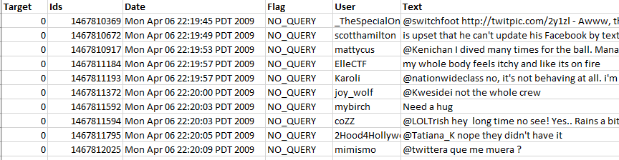
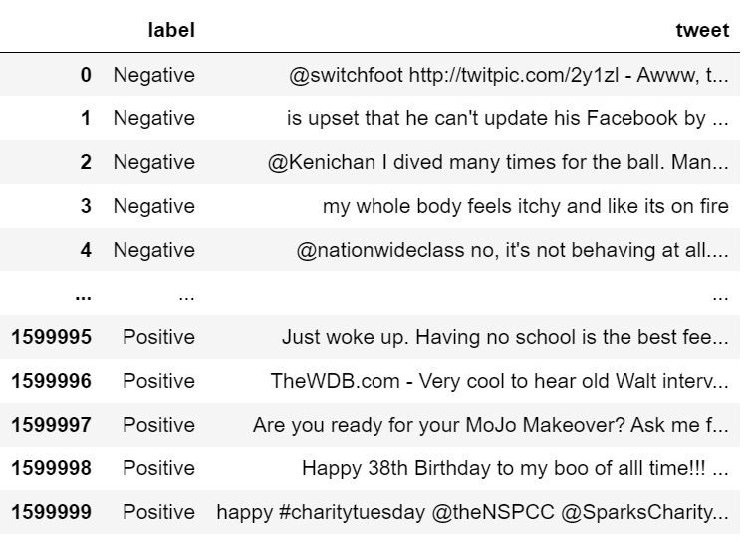
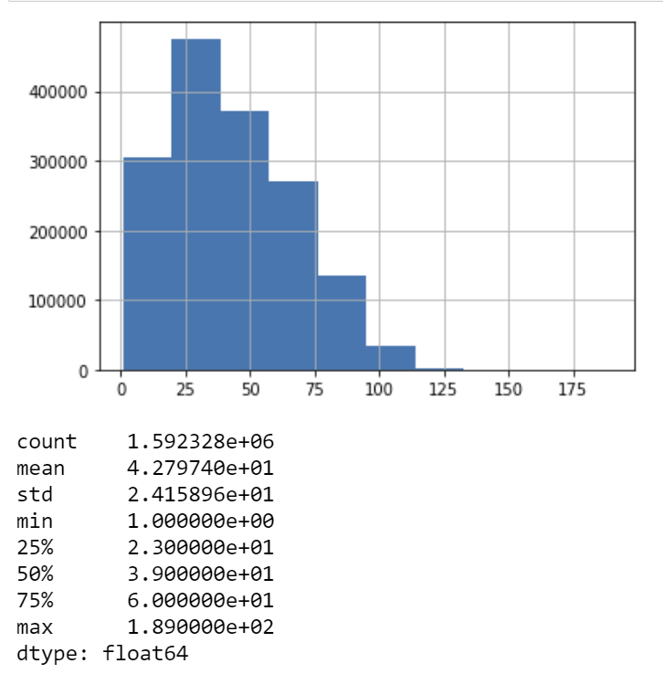
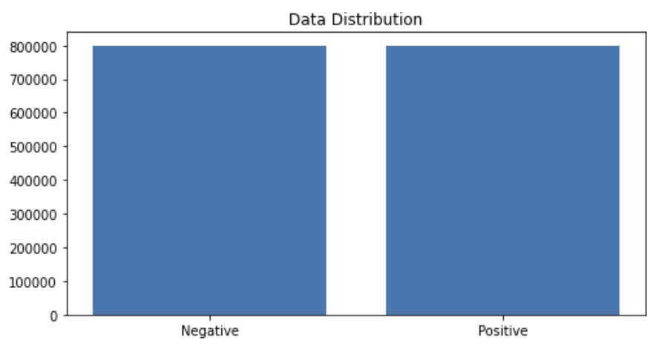
Dataset
Figure 1. A sample from the dataset.
The dataset contains 1,600,000 tweets extracted using the twitter api. The tweets have been classified from 0 (negative) to 4 (positive). The dataset contains 6 fields which are target as integer, ids as integer, date as date, flag as string, user as string and text as string. These 6 fields are shown below.
target: The polarity of the tweet (0 - negative, 2 - neutral, 4 - positive)
ids: The id of the tweet.
date: The date of the tweet.
flag: The query. If there is no query, then this value is NO_QUERY.
user: The user that tweeted.
text: The text of the tweet
Figure 2. Dataset after reduction.
Figure 3. Data distribution.

Slide 4
Project Delivery #2-3
Exploring Your Data

Slide 5
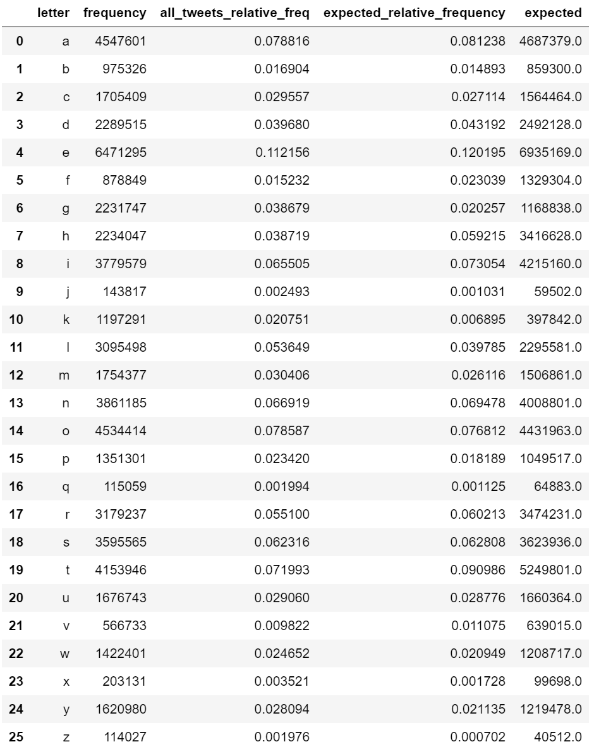
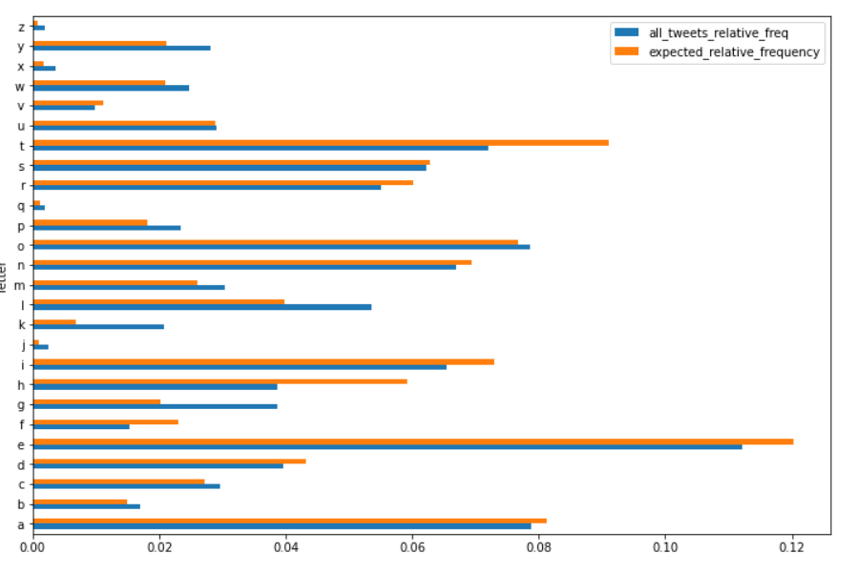
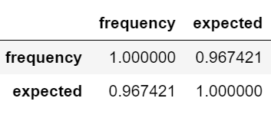
Exploring Our Data in terms of Letter Frequency
Figure 6. Correlation
We got the p-value (p) as 0 which implies that the letter frequency does not follow the same distribution with what we see in English tests, although the Pearson correlation is too high (~96.7%)
.
Figure 4. Letter frequencies of each 26 characters in English Alphabet.
Figure 5. Letter frequency of the dataset, relative frequencies of the dataset, expected relative frequency according to the English language and expected character length according to the English language.

Slide 6
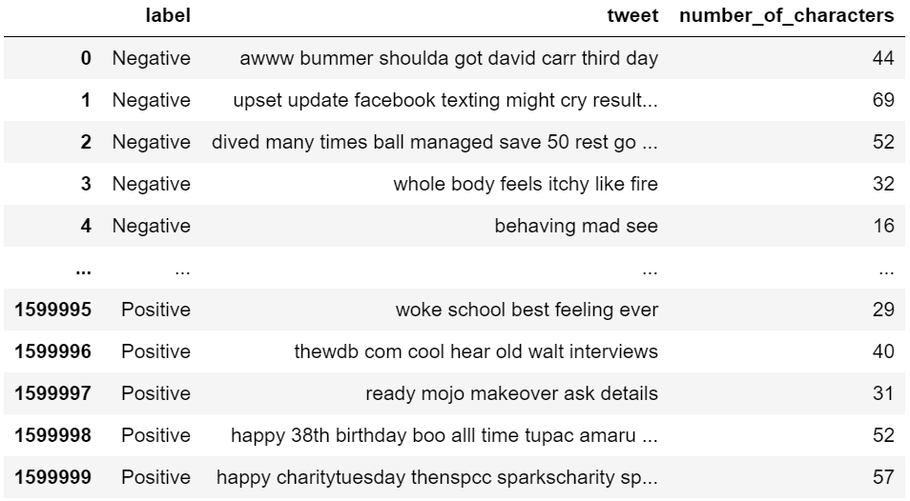
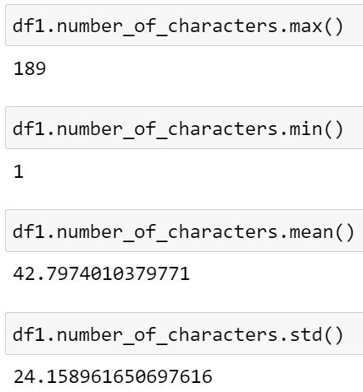
Exploring Our Data in terms of Letter Frequency
We counted the number of characters for each tweet and analyzed the data frame according to maximum number of characters, minimum number of characters, mean of the number of characters column and its standard deviation. Our longest tweet is 189 characters long, the shortest tweet is 1 character long and mean of all tweets’ character length 42.78. The standard deviation of all tweet character length is 24.16 as shown in Figure 8.
Figure 7. Number of characters.
Figure 8. Letter frequency of the dataset, relative frequencies of the dataset, expected relative frequency according to the English language and expected character length according to the English language.

Slide 7
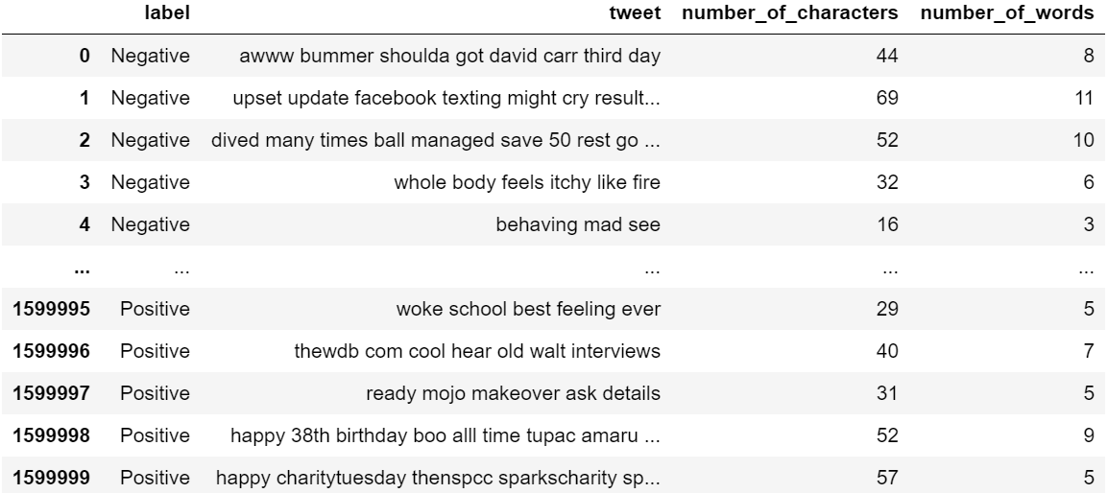
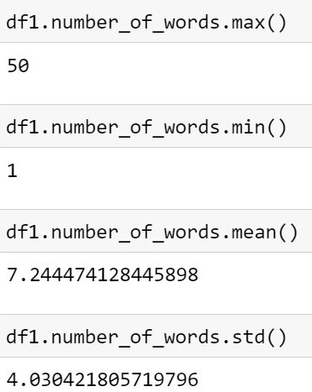
Exploring Our Data in terms of Word Frequency
We counted the number of words for each tweet and analyzed the data frame according to maximum number of words, minimum number of words, mean of the number of words column and its standard deviation. Our longest tweet is 50 words long, the shortest tweet is 1 word long and the mean of all tweets’ word length is 7.24. The standard deviation of all tweet character length is 4.03 as shown in Figure 10.
Figure 9. Number of words of each tweet.
Figure 10. Max, min, mean and standard deviation of each tweet in terms of number of words.

Slide 8
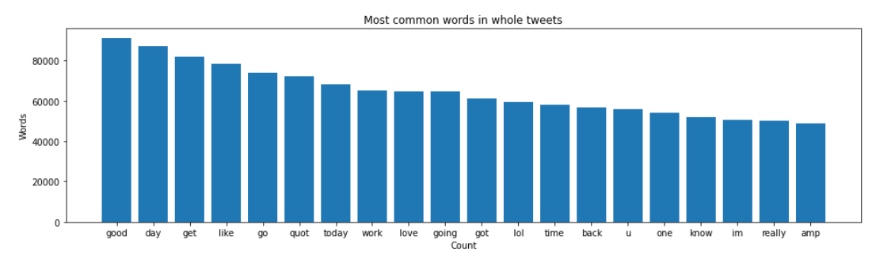
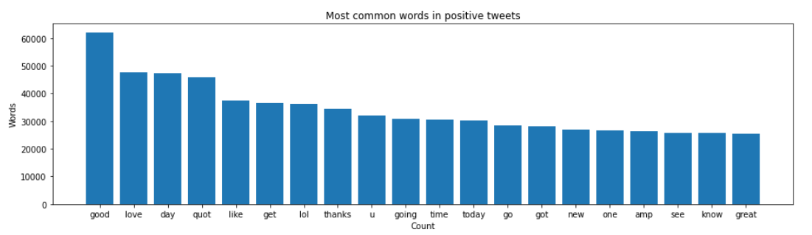
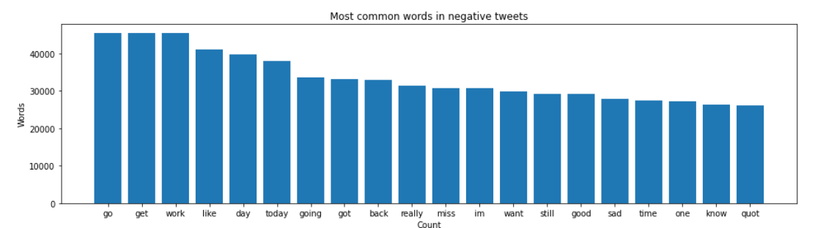
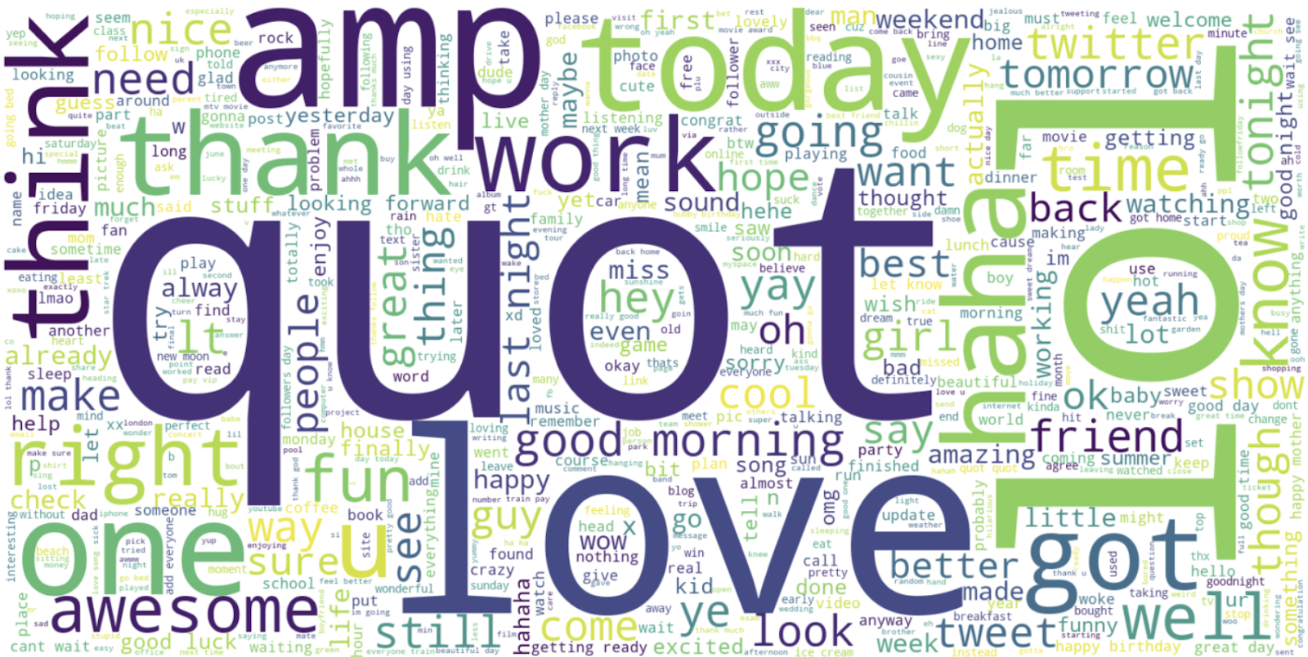
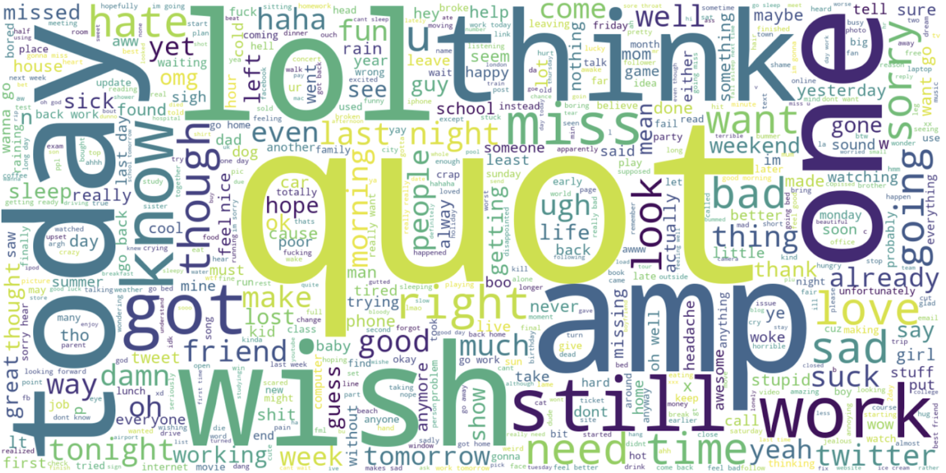
Exploring Our Data in terms of Word Frequency
Figure 11. Most common words in whole data.
Figure 12. Most common words in positive tweets.
Figure 13. Most common words in positive tweets.

Slide 9
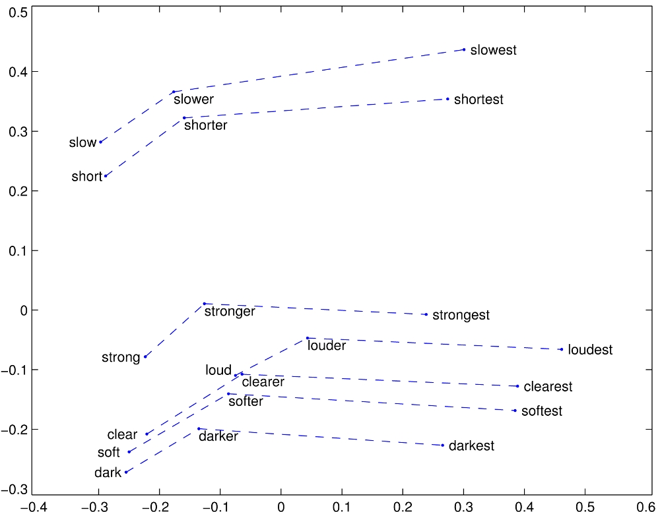
Embedding - Glove
We can train the embedding ourselves. However, that approach can take a long time to train. So, we use transfer learning technique, and we use GloVe: Global Vectors for Word Representation.
The Global Vectors for Word Representation, or GloVe, algorithm is an extension to the word2vec method for efficiently learning word vectors, developed by Pennington, et al. at Stanford. It is an unsupervised learning algorithm for obtaining vector representations for words. Training is performed on aggregated global word-word co-occurrence statistics from a corpus, and the resulting representations showcase interesting linear substructures of the word vector space.
We download the GloVe. Then, we initialize an embedding index that has 400000 word vectors, and embedding matrix.
Figure 14. GloVe embedding example

Slide 10
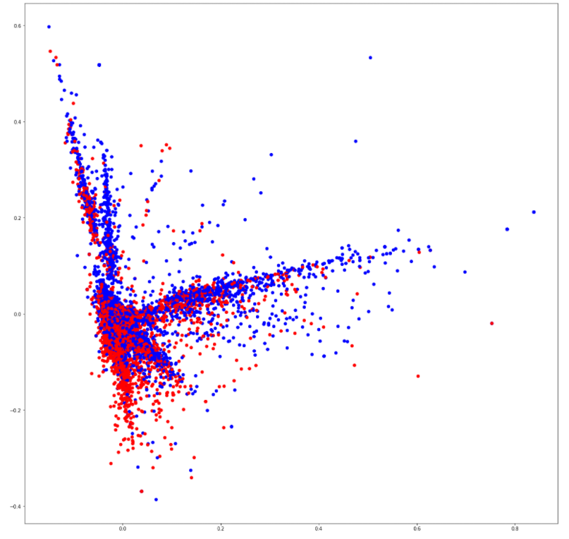
Feature Extraction - Scatter Plot
We used feature extraction methods, bag-of-words, and word embedding. Bag of words with TF-IDF is a common and simple way of feature extraction. Bag-of-Words is a representation model of text data and TF-IDF is a calculation method to score the importance of words in a document.
After applying bag-of-words with TF-IDF, we create the scatter plot according to these results.
Figure 15. Scatter plot that shows correlation of words in the corpus: red indicates negatives, blue indicates positives.

Slide 11
Project Delivery #4
Predictive Analysis

Slide 12
Entropy
At the beginning, our dataset had 6 features which were target, id, date,
query, user and text. We chose two of them for our purpose which are target and
text. We can see that the entropy decreases significantly after this transformation.
First entropy of dataset = 41.08269441306875
Entropy after preprocess = 14.73368002815221

Slide 13
Classification/Regression
For classification/regression experiments, the test set percentage is set to be 20%.
Total Data = Train Data (80%) + Test Data (20%)
Used 3 different algorithm and 6 different model for classification. These are :
LSTM with 1024 Batch Size
LSTM with 512 Batch Size
CNN with 1024 Batch Size
CNN with 512 Batch Size
Multinomial Naive Bayes with Count Vectorizer
Multinomial Naive Bayes with TF-IDF Vectorizer

Slide 14
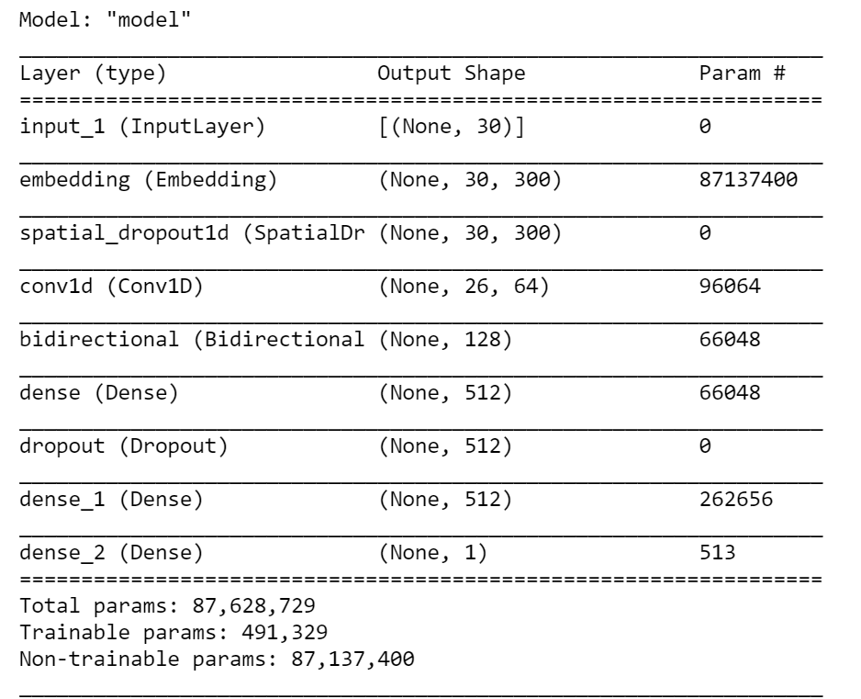
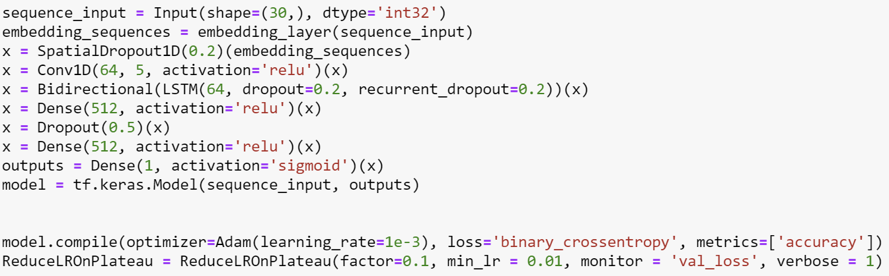
LSTM Model - 1
Batch Size = 1024

Slide 15
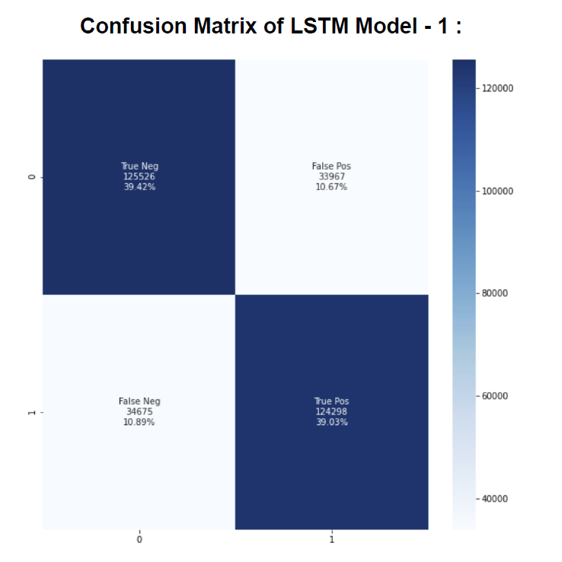
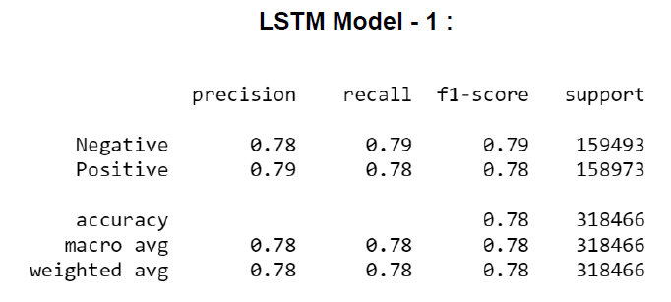
Evaluation Metrics of LSTM Model - 1

Slide 16
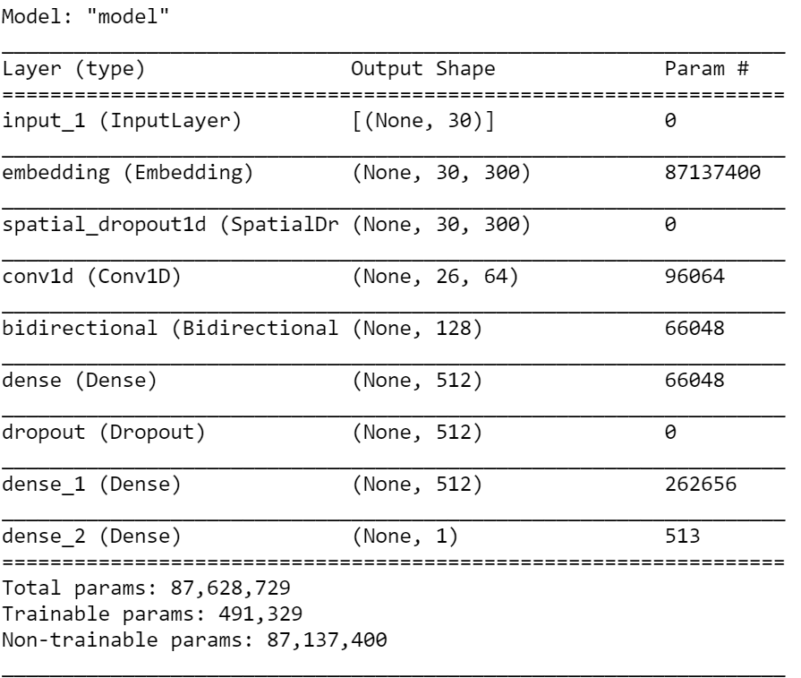
LSTM Model - 2
Batch Size = 512

Slide 17
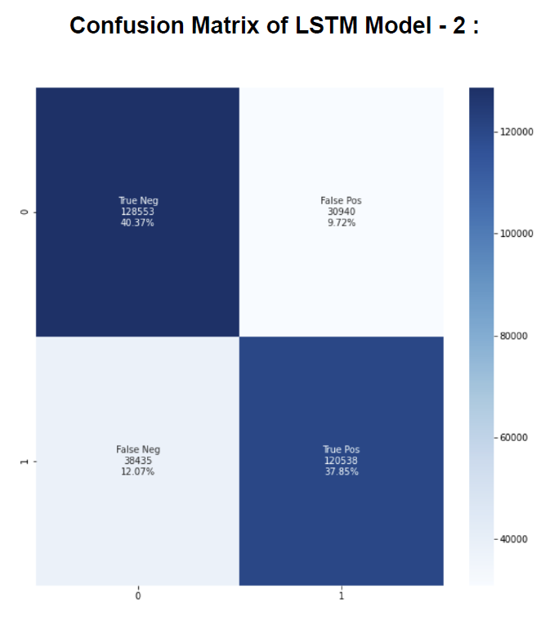
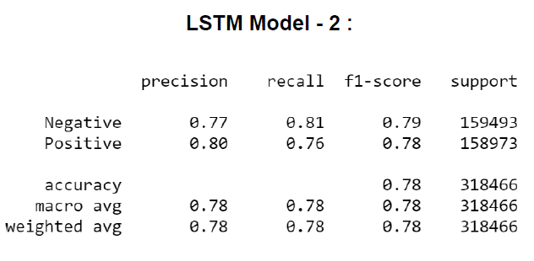
Evaluation Metrics of LSTM Model - 2

Slide 18
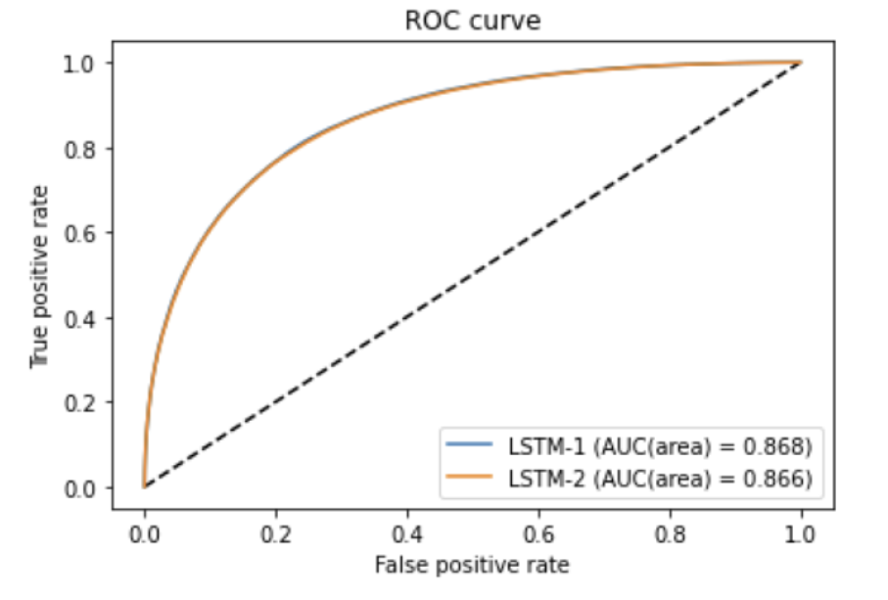
LSTM Model - 1 and LSTM Model - 2
Decreasing the batch size from
1024 to 512 did not make a
significant change in
accuracy.

Slide 19
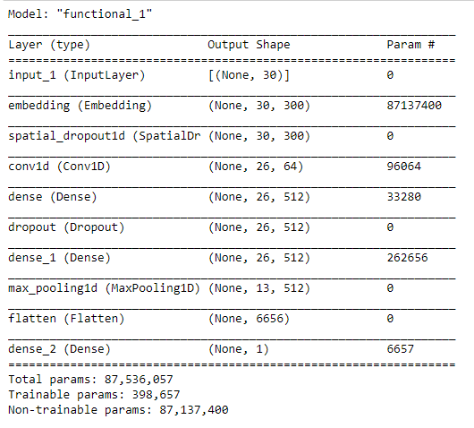
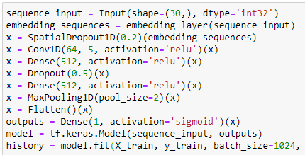
CNN Model - 1
Batch Size = 1024

Slide 20
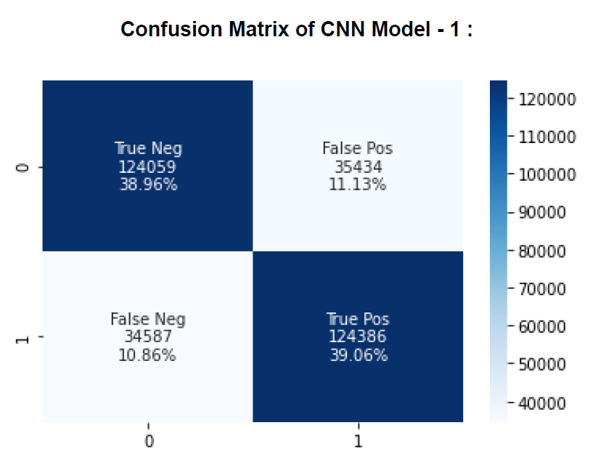
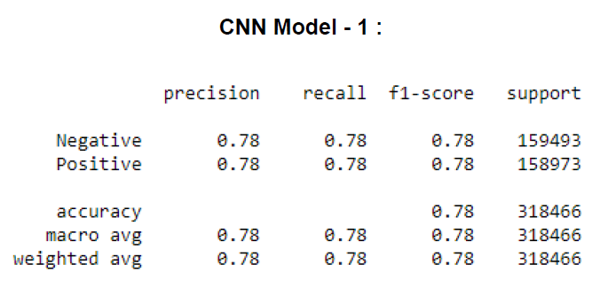
Evaluation Metrics of CNN Model - 1

Slide 21
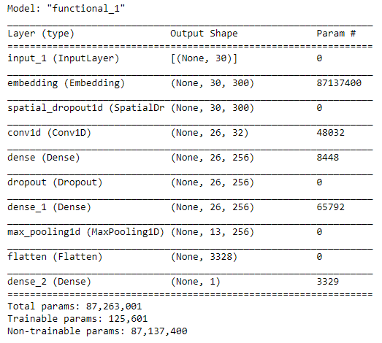
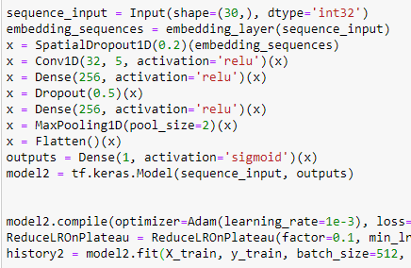
CNN Model - 2
Batch Size = 512

Slide 22
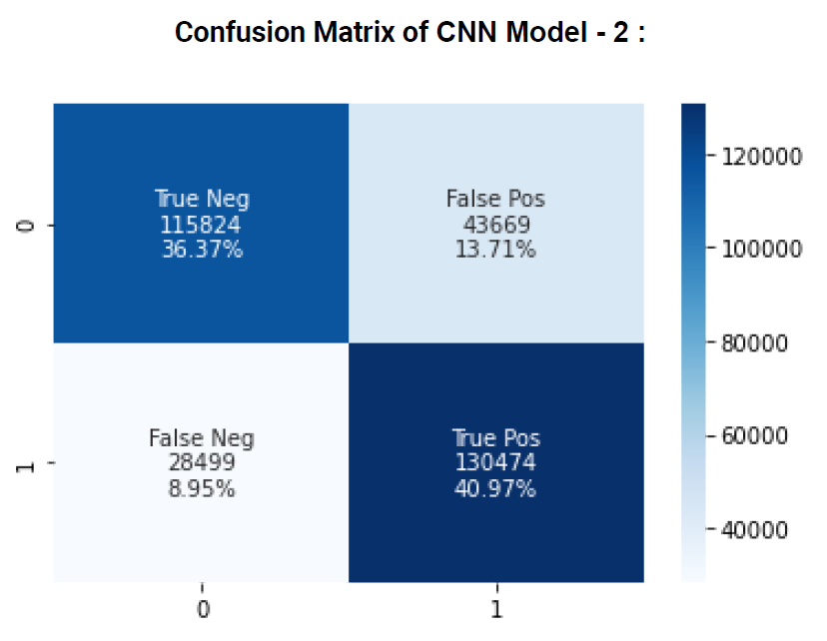
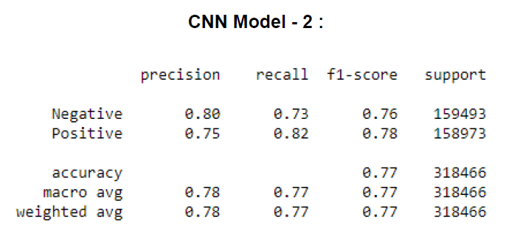
Evaluation Metrics of CNN Model - 2

Slide 23
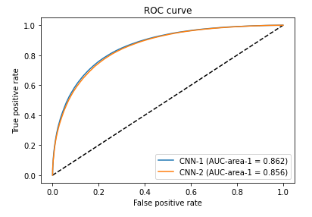
CNN Model - 1 and CNN Model - 2
Decreasing the batch size from
1024 to 512 did not make a
significant change in
accuracy.

Slide 24
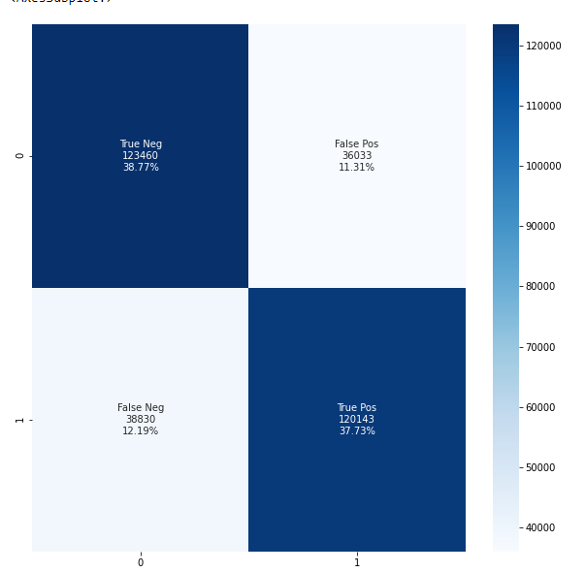
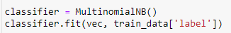
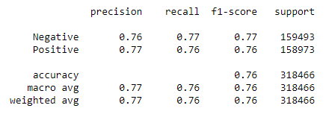
Multinomial Naive Bayes with Count Vectorizer

Slide 25
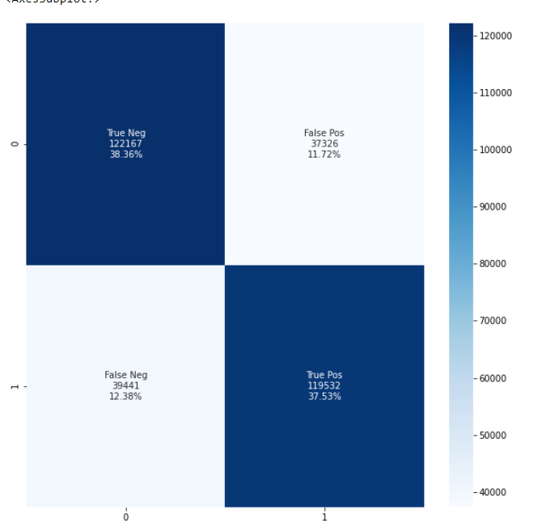
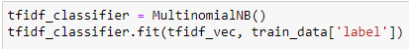
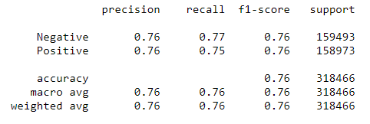
Multinomial Naive Bayes with TF-IDF

Slide 26
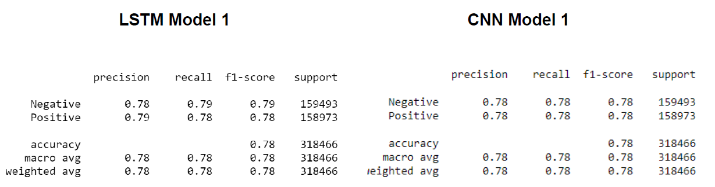
Statistical Significance Analysis
Best performing model is LSTM Model - 1 with accuracy 0.789
Second best performing model is CNN Model - 1 with accuracy 0.781
Multinomial Naive Bayes with TF-IDF is the worst performing algorithm among them with accuracy 0.758.

Slide 27
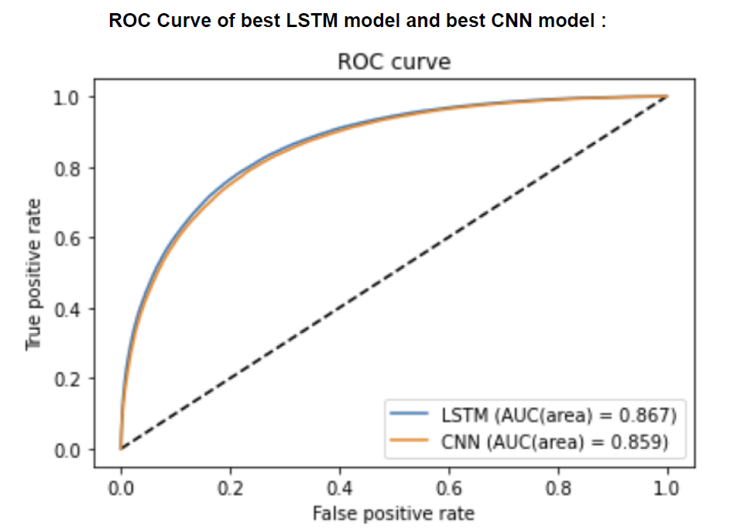
Statistical Significance Analysis
LSTM and CNN results are very close to each other.
Naive Bayes models performed slightly worse.
Naive Bayes models have the best training time durations.

Slide 28
Result
LSTM Model-1 has 78.9% accuracy rate and LSTM model-2 has 78.6% accuracy rate. CNN model-1 has 78.2% accuracy rate and CNN model-2 has 77.2% accuracy rate.
Both algorithms have better training times with 512 batch size, are better than their 1024 batch sized models and their accuracy rates are really close.
As a result of these, we can say that LSTM and CNN models with 1024 batch size are better for accuracy rate. But, models with 512 batch size have close accuracy rates within better training times.
For accuracy rates of Naive Bayes models there is a small difference like 1.5%. As a result of that, we can say that Naive Bayes with the CountVectorizer method gives better results than Naive Bayes with the TF-IDF method.

Slide 29
Project Delivery #5
Descriptive Analytics

Slide 30
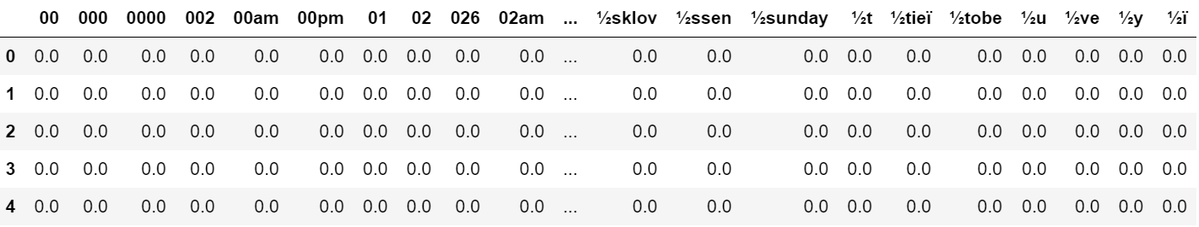
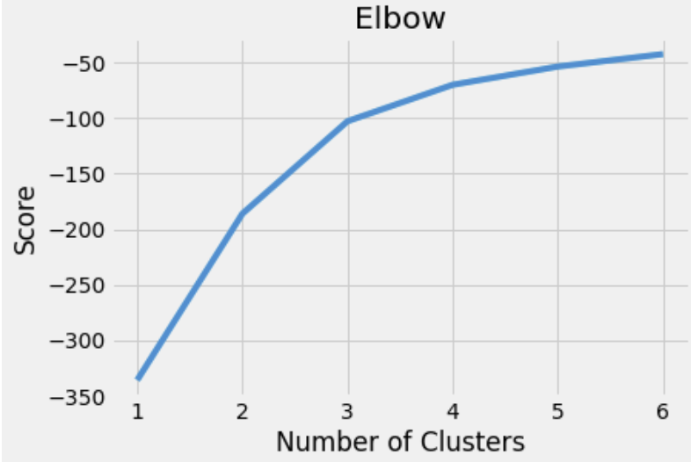
Project Delivery #5 - Descriptive Analytics
We use Term Frequency-Inverse Document Frequency (TF-IDF) to transform the text data. You can obtain the tf-idf array.
Then, we use the Elbow method to make sure we choose the optimal number of clusters. We decided to make experiments 2 and 3 number of clusters.

Slide 31
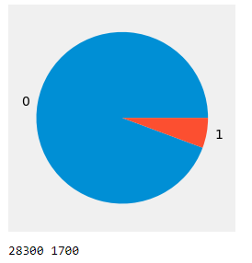
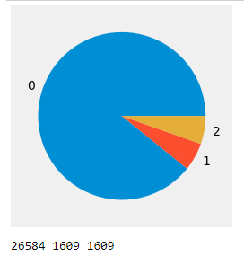
Instance Distribution - Pie Charts
Cluster 0 Percentage = 88.6%
Cluster 1 Percentage = 5.7%
Cluster 2 Percentage = 5.7%
Figure 4. A pie chart showing the instance distributions for 3 clusters.
Cluster 0 Percentage = 94.3%
Cluster 1 Percentage = 5.7%
Figure 3. A pie chart showing the instance distributions for 2 clusters.

Slide 32
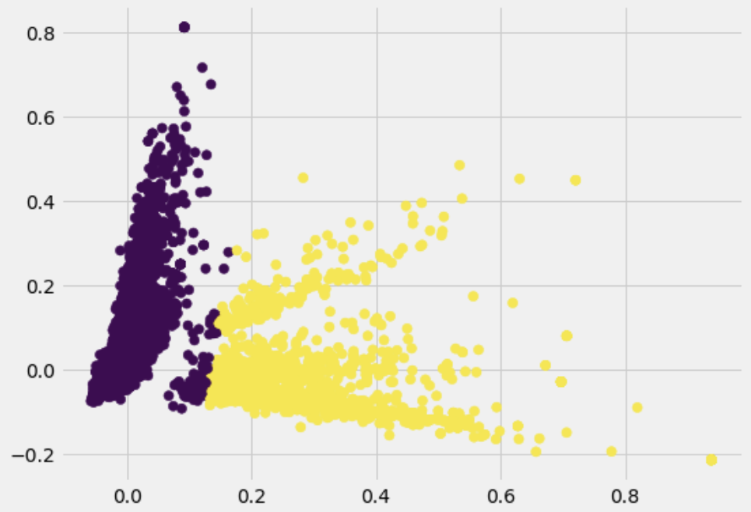
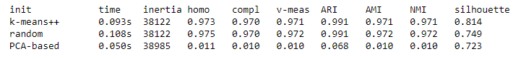
Evaluation of Experiments - Experiment 1 Number of Clusters = 2
Evaluation metrics for 2 clusters.

Slide 33
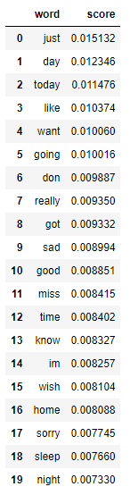

Most important words in Cluster 0
Most important words in Cluster 1

Slide 34


Evaluation of Experiments - Experiment 2 Number of Clusters = 3
Evaluation metrics for 2 clusters.

Slide 35



Most important words in Cluster 0
Most important words in Cluster 1
Most important words in Cluster 2

Slide 36
Result
K-means is a very simple and powerful algorithm to cluster a dataset. However, one of the problems is that clusters are spherical. Therefore, it can not be reliable for all situations.
We are using text data for our project. So, we need to represent the data as the model understands. For this reason, firstly, we vectorize our data with tf-idf vectorizer. Then, we use the elbow method to make sure we choose the optimal number of clusters. We decided to make experiments with 2 and 3 numbers of clusters.
The K-means is clustering words according to some semblance of meaning in our experiments, but experiments can be developed with even more accurate parameters.

Slide 37
Thank you for listening

